Slide 1
Internal Presenter Notes: What Attendees Should Take Away
What is Azure Data Factory (ADF)
Ingesting data with ADF
Monitoring data with ADF

Slide 3
Ingesting data for analytics workloads
Speaker name
Title
Notes:
To build their analytics solution, Tailwind Traders needs to derive insights from a variety of data sources.
Tailwind Traders uses Azure Data Factory to create data pipelines for data ingestion in preparation for analytics

Slide 4
Resources
Session Resources Hub
aka.ms/DATA20
Session Code on GitHub
aka.ms/DATA20Repo
All Event Session Resources
aka.ms/mymsignitethetour
Notes:
TALKING POINTS
In the session, we’ll have demo assets that you would be able to use afterwards for your own learning and exploration.
I encourage you to look at those, capture and review them later.

Slide 5
Agenda
What is Azure Data Factory?
Ingesting data
Monitoring
Notes:
TALKING POINTS
In this session well cover a set of topics that will increase your understanding on what Azure Data Factory is, how it is being used, and how to perform data ingestion using Azure Data Factory

Slide 6
What is Azure Data Factory?
Notes:
TALKING POINTS
So Let’s dig in …. What is Azure Data Factory?
How many of you have used data ingestion tools previously?
PRESENTER NOTES AND GUIDANCE
Poll your audience, ask them for examples on data ingestion, get conversational on the topic, but don’t spend too much time.

Slide 7
Azure Data Factory
A cloud-based data integration service that allows you to orchestrate and automate
data movement and data transformation.
Notes:
TALKING POINTS
Azure Data Factory is the cloud-based ETL and data integration service that allows you to create data-driven workflows for orchestrating data movement and transforming data at scale.
Using Azure Data Factory, you can create and schedule data-driven workflows (called pipelines) that can ingest data from disparate data stores. You can build complex ETL processes that transform data visually with data flows or by using compute services such as Azure HDInsight Hadoop, Azure Databricks, and Azure SQL Database.
PRESENTER NOTES AND GUIDANCE
In this slide be sure to clarify the word orchestrate. Whilst ADF has the ability to perform data movement and transformation itself, it can also perform this by orchestrating the activities of other Azure compute resources such as HDInsight, Databricks or ML services. It also has the ability to make use of existing SSIS packages that an organization might have. Inform the students that this learning path focusses on the native functionality of ADF version 2 to perform the data movement and transformation.
Refresh yourself with an overview of Azure Data Factory with the following link:
https://docs.microsoft.com/en-gb/learn/modules/evolving-world-of-data/index
Read this content that shows the benefits of the cloud over on premises implementations
https://docs.microsoft.com/en-gb/learn/modules/principles-cloud-computing/index
For basic data storage options, read this:
https://docs.microsoft.com/en-gb/learn/modules/intro-to-data-in-azure/index

Slide 8
Azure Data Factory process
Transform
& Enrich
Connect & Collect
Publish
Monitor
Notes:
TALKING POINTS
<Click>
In a typical process of data ingestion, several steps come into place
The first step is making the connection to your data sources, defining the connection to the source data.
<Click>
By either using native ADF functionality, making call to external compute resource (for example a stored procedure in Azure SQL Database, or to a model in Machine Learning Services), or through the integration of SSIS packages, you can perform transformations that will clean or modify the data. You could also enrich that data which means that you perform an analysis that augments the data or creates new data.
<Click>
After the raw data has been refined into a business-ready consumable form, load the data into Azure Synapse Analytics, Azure SQL Database, Azure CosmosDB, or whichever analytics engine your business users can point to from their business intelligence tools.
<Click>
As ADF will perform a regular schedule of data movement activities, it’s important to get a monitoring solution in place to ensure you keep on top of any errors or issues that may occur in the day to day running of the solution
PRESENTER NOTES AND GUIDANCE
This information is used to serve as a reminder of information you will need to know to present this slide
Refresh yourself with an overview of Azure Data Factory with the following link:
https://docs.microsoft.com/en-us/azure/data-factory/introduction#how-does-it-work

Slide 9



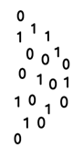



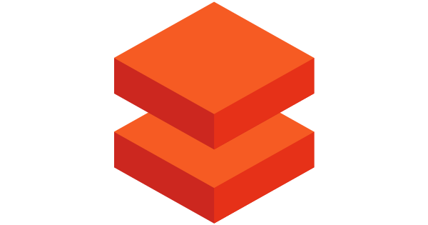
Azure Data Factory Components
@
Triggers
Parameters
Linked Service
IR
Integration
Runtime
CF
Control
Flow
Pipeline
Data Lake Store
1
Activities
Azure Databricks
Dataset
Notes:
TALKING POINTS
Let’s have a closer look at the components of Azure Data Factory
Linked services
Linked services are much like connection strings, which define the connection information that's needed for Data Factory to connect to external resources. Think of it this way: a linked service defines the connection to the data source, and a dataset represents the structure of the data. For example, an Azure Storage-linked service specifies a connection string to connect to the Azure Storage account. Additionally, an Azure blob dataset specifies the blob container and the folder that contains the data.
Linked services are used for two purposes in Data Factory:
To represent a data store that includes, but isn't limited to, an on-premises SQL Server database, Oracle database, file share, or Azure blob storage account. For a list of supported data stores, see the copy activity article.
To represent a compute resource that can host the execution of an activity. For example, the HDInsightHive activity runs on an HDInsight Hadoop cluster. For a list of transformation activities and supported compute environments, see the transform data article.
Datasets
Datasets represent data structures within the data stores, which simply point to or reference the data you want to use in your activities as inputs or outputs.
Activity
Activities represent a processing step in a pipeline. For example, you might use a copy activity to copy data from one data store to another data store. Similarly, you might use a Hive activity, which runs a Hive query on an Azure HDInsight cluster, to transform or analyze your data. Data Factory supports three types of activities: data movement activities, data transformation activities, and control activities.
Pipeline
A data factory might have one or more pipelines. A pipeline is a logical grouping of activities that performs a unit of work. Together, the activities in a pipeline perform a task. For example, a pipeline can contain a group of activities that ingests data from an Azure blob, and then runs a Hive query on an HDInsight cluster to partition the data.
The benefit of this is that the pipeline allows you to manage the activities as a set instead of managing each one individually. The activities in a pipeline can be chained together to operate sequentially, or they can operate independently in parallel.
Triggers
Triggers represent the unit of processing that determines when a pipeline execution needs to be kicked off. There are different types of triggers for different types of events.
Pipeline runs
A pipeline run is an instance of the pipeline execution. Pipeline runs are typically instantiated by passing the arguments to the parameters that are defined in pipelines. The arguments can be passed manually or within the trigger definition.
Parameters
Parameters are key-value pairs of read-only configuration. Parameters are defined in the pipeline. The arguments for the defined parameters are passed during execution from the run context that was created by a trigger or a pipeline that was executed manually. Activities within the pipeline consume the parameter values.
A dataset is a strongly typed parameter and a reusable/referenceable entity. An activity can reference datasets and can consume the properties that are defined in the dataset definition.
A linked service is also a strongly typed parameter that contains the connection information to either a data store or a compute environment. It is also a reusable/referenceable entity.
Control flow
Control flow is an orchestration of pipeline activities that includes chaining activities in a sequence, branching, defining parameters at the pipeline level, and passing arguments while invoking the pipeline on-demand or from a trigger. It also includes custom-state passing and looping containers, that is, For-each iterators.
Variables
Variables can be used inside of pipelines to store temporary values and can also be used in conjunction with parameters to enable passing values between pipelines, data flows, and other activities.
PRESENTER NOTES AND GUIDANCE
This information is used to serve as a reminder of information you will need to know to present this slide
Refresh yourself with an overview of Azure Data Factory with the following link:
https://docs.microsoft.com/en-us/azure/data-factory/introduction#top-level-concepts

Slide 10
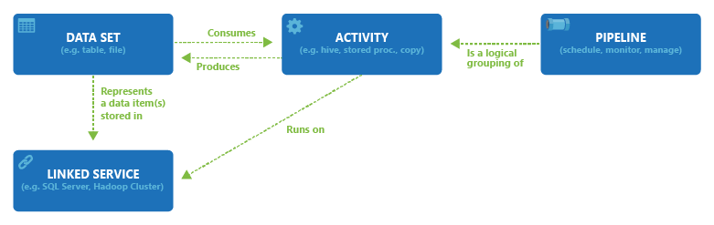
Component dependencies
Notes:
HIDDEN SLIDE
PRESENTER NOTES AND GUIDANCE
This information is used to serve as a reminder of information you will need to know to present this slide
Refresh yourself with an overview of Azure Data Factory with the following link:
https://docs.microsoft.com/en-us/azure/data-factory/concepts-linked-services

Slide 11
Ingesting data
Notes:
TALKING POINTS
As we described the components of Azure Data Factory, let’s have a closer look at the Data Ingestion process

Slide 12
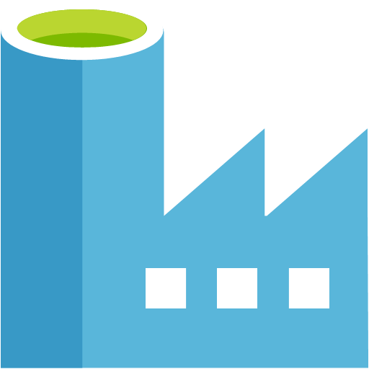

Data transformation in Azure
Transforming data with Azure Data Factory
Data preparation
Read data from files using DBFS
Load processed data into tables optimized for analytics
ADF Copy Activity
Connect & Collect
Azure Databricks
Data ingestion
Data storage
Load flat files
into data lake on a schedule
Applications
Load into SQL DW tables
Visualize
Logs, files, and media
(unstructured)
Azure Data Factory
Azure Storage/ Data Lake Store
Azure Synapse Analytics
Power BI
Dashboards
Serving
Business and custom apps (structured)
Applications manage their transactional data directly
Extract and transform relational data
Azure Data Factory
SQL DB
Transactional storage
Data prep.
Notes:
TALKING POINTS
Let’s have a look at an architectural diagram of a data transformation process with Azure Data Factory.
You probably can think about many business processes that have the need to ingest data files, log files, for which we can use Azure Data Factory loading flatfiles into Azure Data Lake Storage, which could then be the source for a load process into a data warehouse in Azure Synapse Analytics.
<Click>
The Connect and Collect process, is key to the ADF Copy Activity which we’ll configure and run in a demo later.
PRESENTER NOTES AND GUIDANCE
Refresh yourself with an overview of Azure Data Factory with the following link:
https://docs.microsoft.com/en-us/azure/data-factory/copy-activity-overview

Slide 13
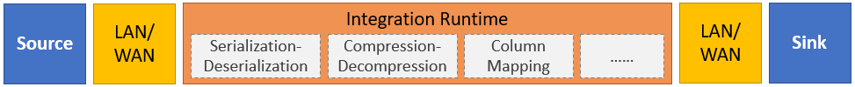
Copy Activity process
Reads data from a source data store.
Performs serialization/deserialization, compression/decompression, column mapping, and so on. It performs these operations based on the configuration of the input dataset, output dataset, and Copy activity.
Writes data to the sink/destination data store
Notes:
TALKING POINTS
The Copy Activity process, reads the data from the source, and is executed through the Integration runtime.
The runtime itself, performs a serialization/deserialization process, compression/decompression and the column mapping.
These steps are performed based on the input configuration of the source dataset, the output dataset, and execution configuration set on the copy activity.
The data then gets written to the destination, often referred to as Sink
PRESENTER NOTES AND GUIDANCE
This information is used to serve as a reminder of information you will need to know to present this slide
Refresh yourself with an overview of Azure Data Factory with the following link:
https://docs.microsoft.com/en-us/azure/data-factory/copy-activity-overview#supported-data-stores-and-formats

Slide 14
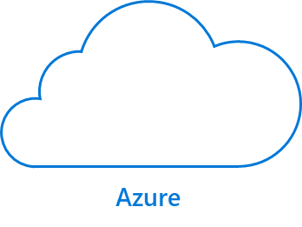
Integration Runtime
IR
IR
SQL Server
Azure Integration
Runtime
Self-hosted
Integration Runtime
Notes:
TALKING POINTS
The Copy activity is executed on an integration runtime.
Different types of integration runtimes for different data copy scenarios:
When you're copying data between two data stores that are publicly accessible through the internet from any IP, you can use the Azure integration runtime for the copy activity. This integration runtime is secure, reliable, scalable, and globally available.
When you're copying data to and from data stores that are located on-premises or in a network with access control (for example, an Azure virtual network), you need to set up a self-hosted integration runtime.
An integration runtime needs to be associated with each source and sink data store.
PRESENTER NOTES AND GUIDANCE
This information is used to serve as a reminder of information you will need to know to present this slide
Refresh yourself with an overview of Azure Data Factory with the following link:
https://docs.microsoft.com/en-us/azure/data-factory/concepts-integration-runtime
For information about how the Copy activity determines which integration runtime to use, see
https://docs.microsoft.com/en-us/azure/data-factory/concepts-integration-runtime#determining-which-ir-to-use

Slide 15
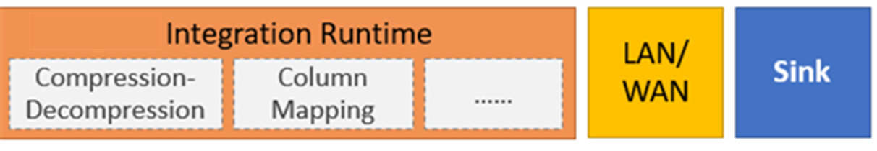
Copy files with the Copy Activity
Copy activity can compress
and decompress files with
The following codecs:
Gzip
Deflate
Bzip2
ZipDeflate
Supported file formats:
Text
JSON
Avro
ORC
Parquet
Notes:
TALKING POINTS
To copy files, using the Copy Activity, ADF supports a set of supported file formats, which can also be compressed/decompressed using a variety of codecs.
PRESENTER NOTES AND GUIDANCE
This information is used to serve as a reminder of information you will need to know to present this slide
Refresh yourself with an overview of Azure Data Factory with the following link:
https://docs.microsoft.com/en-us/azure/data-factory/copy-activity-overview

Slide 16
Demo: Ingesting data with Azure Data Factory
Notes:
TALKING POINTS
Let’s put this into reality and show you how it works.
REVIEW THE DETAILED DEMO GUIDE FOR STEPS AND PREREQUISITES

Slide 17
Monitoring data ingestion
Notes:
Instructor notes.
In providing these notes, it is assumed that you are qualifies in the Microsoft Certified: Azure Data Engineer Associate and have passed both exams DP200 and DP201
Presentation direction
Treat this slide as a divider slide

Slide 18
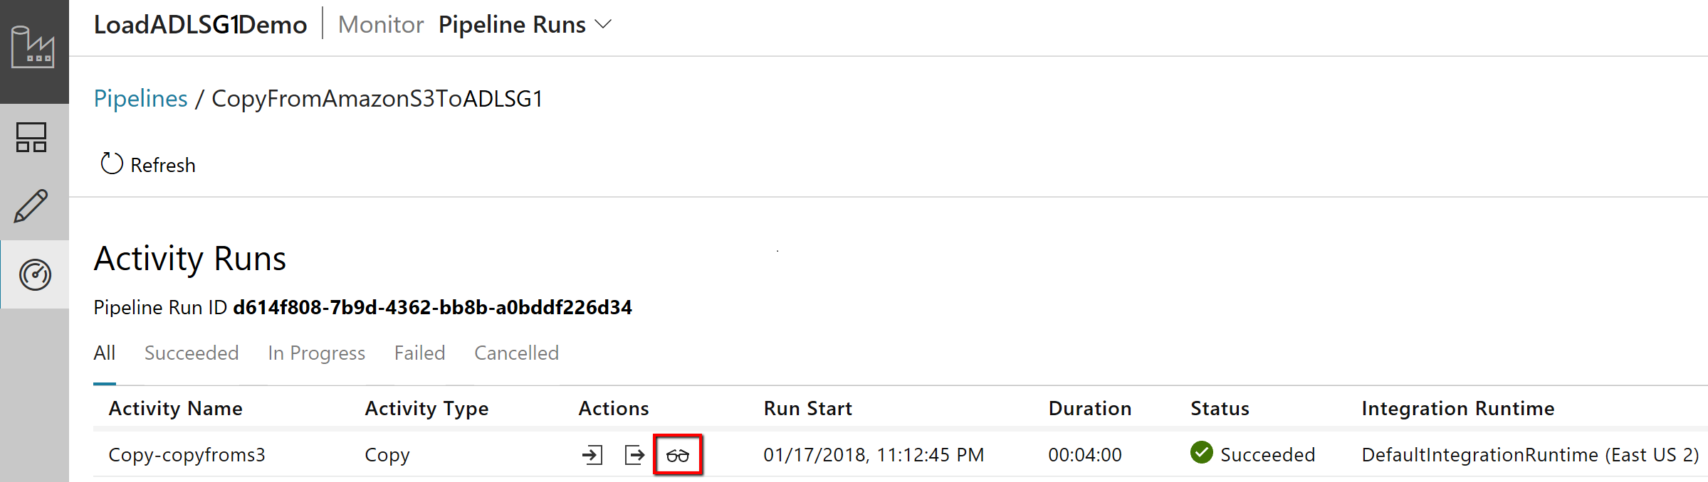
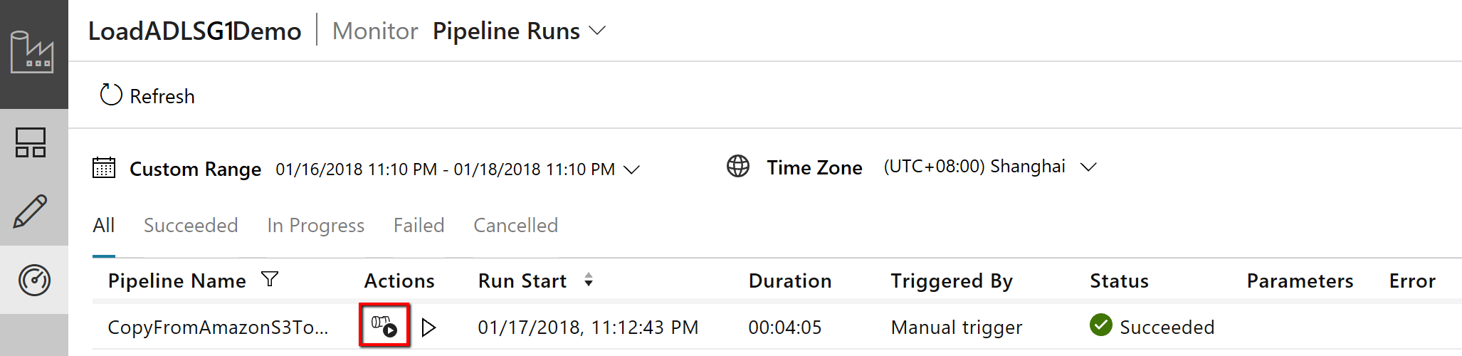
Monitoring
Activity runs
Pipeline runs
Notes:
TALKING POINTS
As you’ve seen in the demo, you can easily monitor the Copy Activity run and monitor subsequent execution using the Azure Data Factory Author & Monitor in the UI or programmatically
<Click>
To visually monitor the Copy activity run, go to your data factory and then go to Author & Monitor. On the Monitor tab, you see a list of pipeline runs with a View Activity Run button in the Actions column:
Select View Activity Runs to see the list of activities in the pipeline run. In the Actions column, you see links to the Copy activity input, output, errors (if the Copy activity run fails), and details:
Select the Details button in the Actions column to see the Copy activity's execution details and performance characteristics. You see information like volume/number of rows/number of files of data copied from source to sink, throughput, steps the Copy activity goes through with corresponding durations, and configurations used for your copy scenario.
PRESENTER NOTES AND GUIDANCE
Refresh yourself with an overview of Azure Data Factory Monitoring with the following link:
https://docs.microsoft.com/en-us/azure/data-factory/monitor-visually

Slide 19

In Summary: Ingesting Data with Azure Data Factory
Azure Data Factory (ADF) is a cloud-based data integration service that allows you to orchestrate and automate data movement and data transformation.
Ingesting data can be performed by the ADF Copy Activity
The ADF Copy Activity can be used to connect and collect data for ingestion, and to publish data to BI tools and applications.
Different Integration Runtimes are required for different ingestion scenarios
File copy are very efficient using the ADF Copy Activity
You can monitor the performance of the ADF Copy Activity both visually and programmatically

Slide 20
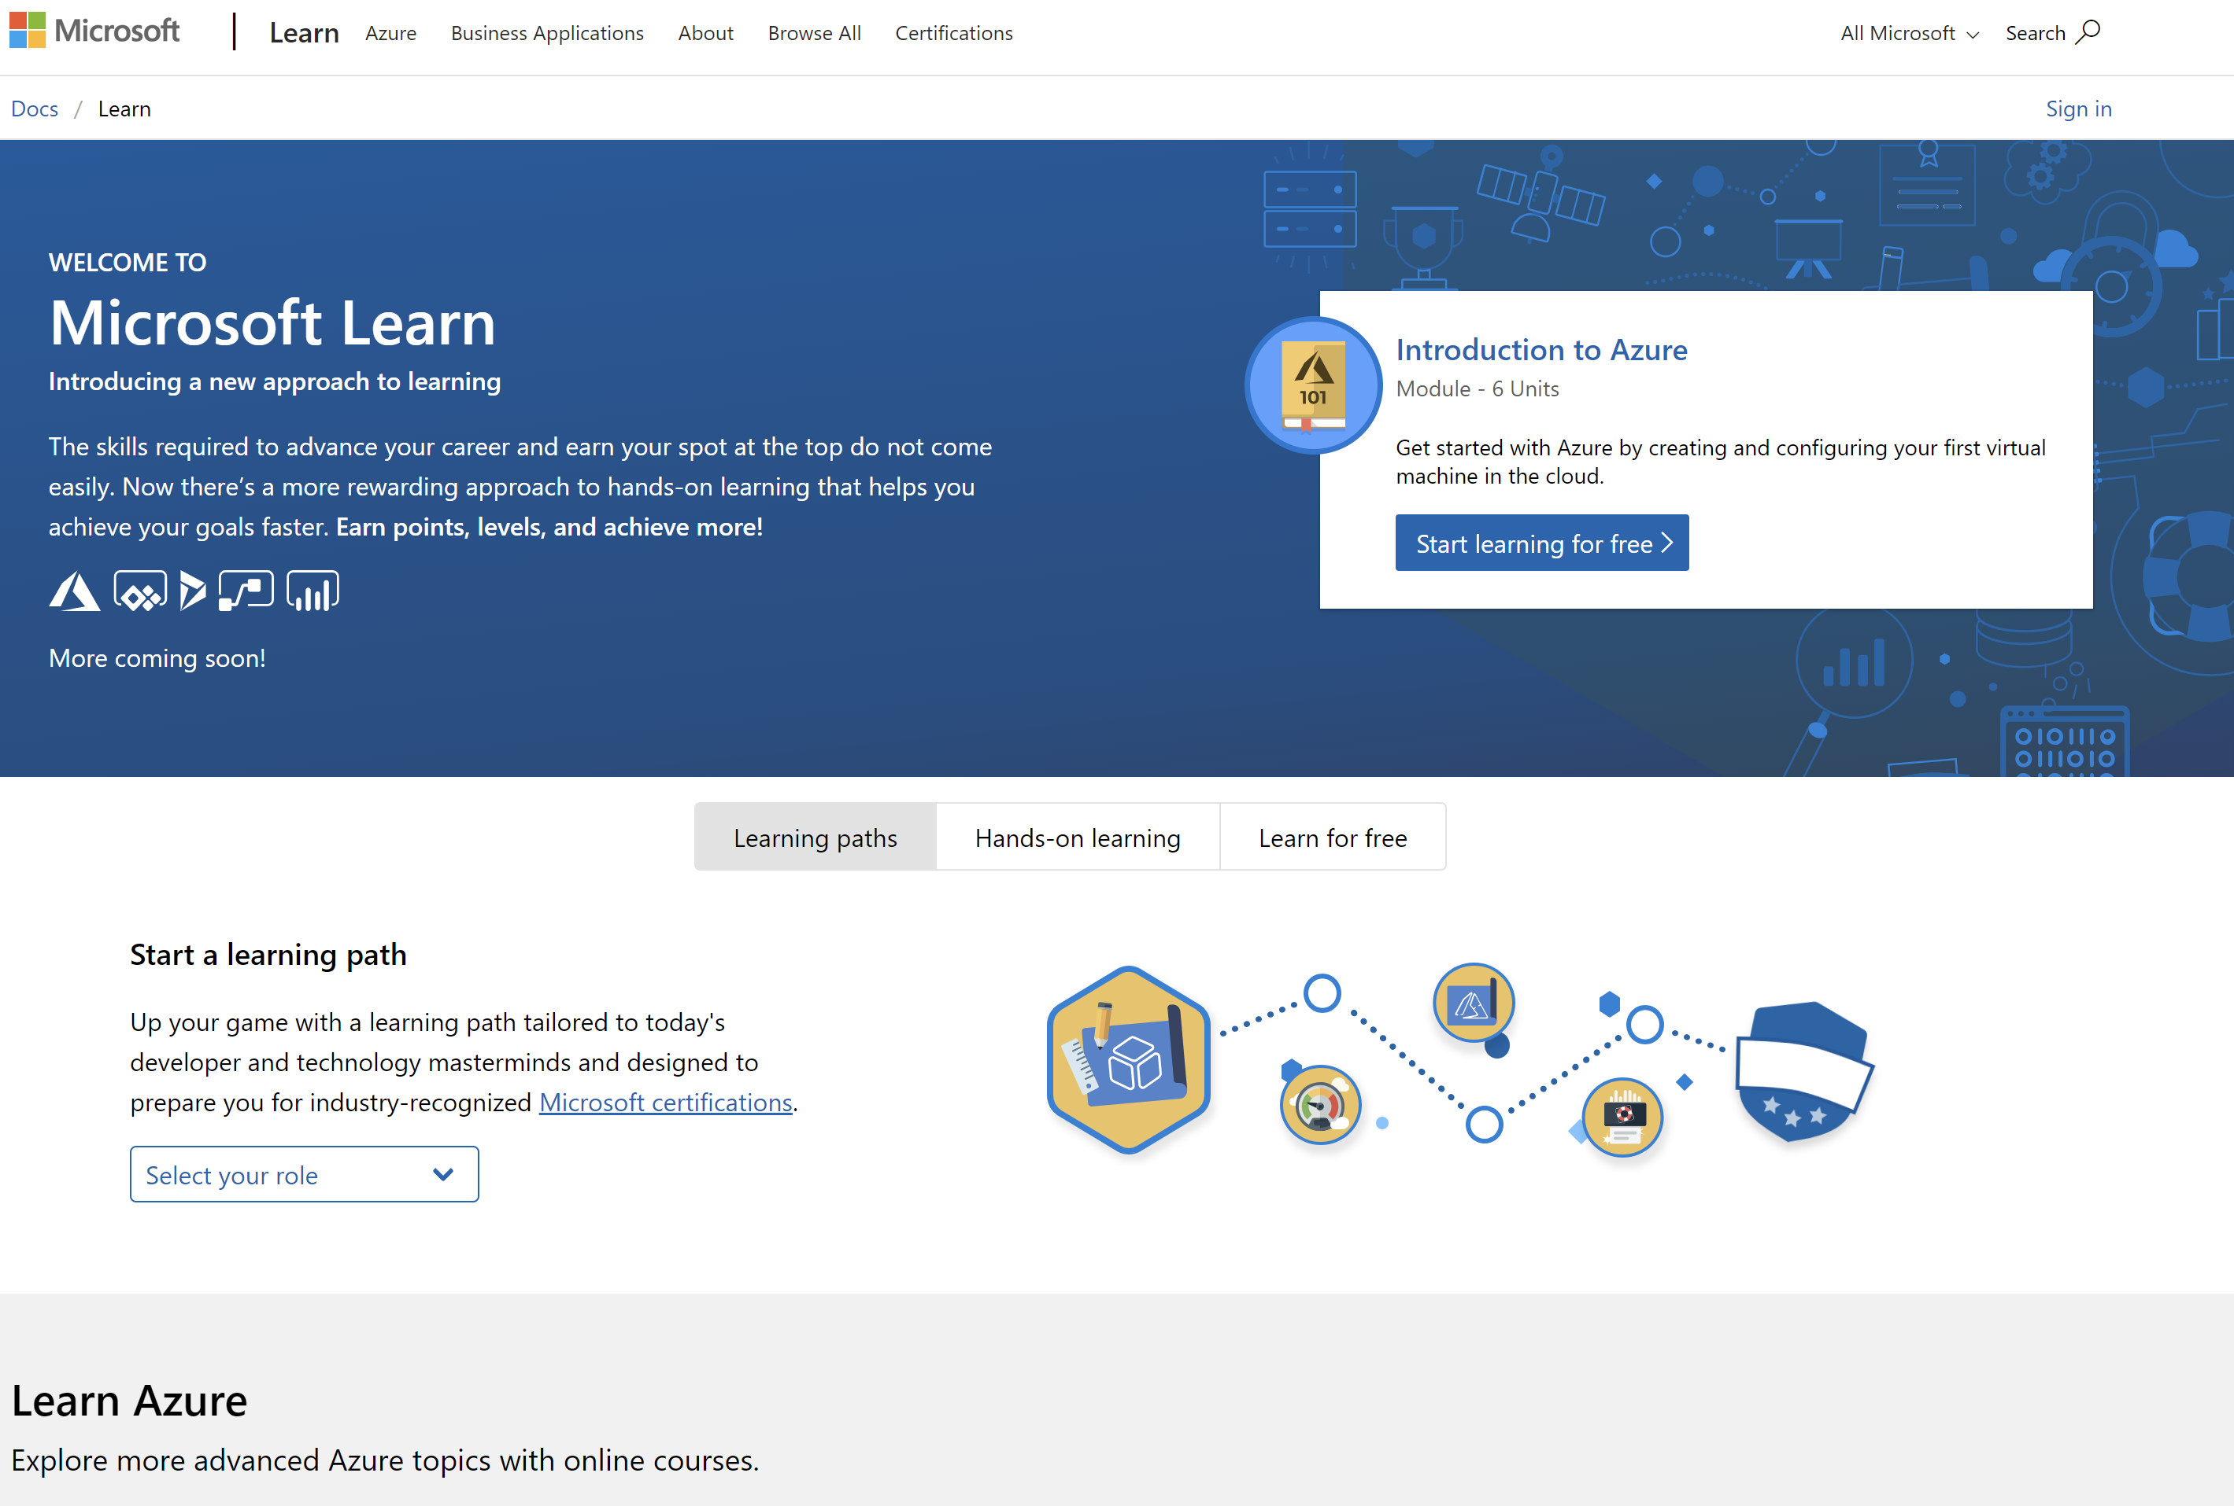
/MS Learn alert
Complete interactive learning exercises, watch videos, and practice and apply your new skills.
aka.ms/DATA20MSLearnCollection

Slide 21

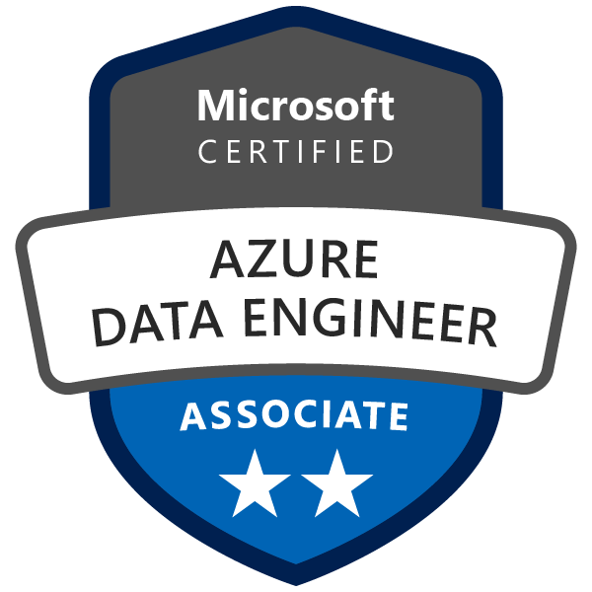
Get Certified
Resources
Session Resources
aka.ms/DATA20
Session Code on GitHub
aka.ms/DATA20repo
All Event Resources
aka.ms/mymsignitethetour
aka.ms/azuredataengineer
#MSIgniteTheTour
Notes:
TALKING POINTS
As mentioned at the beginning of the session, we bundled all resources related to this session.
This Learning Path provides a step towards pursuing the Microsoft Certified: Azure Data Engineer Associate level certification.
The link to this certification, and the skills being measured on the certification exams associated with this role-based certifications are available for you here.

Slide 22
Ingesting data for analytics workloads
Speaker name
Title

